Slide 1
WHO Labour Care Guide

Slide 2
Introduction
More than 1/3 of maternal deaths, ½ of stillbirths and a ¼ of neonatal deaths result from complications during labour and childbirth.
The majority of these deaths occur in low-resource settings and are largely preventable through timely interventions .
1- Monitoring of labour and childbirth.
2- early identification and treatment of complications are critical for preventing adverse birth outcomes.
3- Improving the quality of care around the time of birth has been identified as the most impactful strategy for reducing stillbirths and maternal and newborn deaths, compared with antenatal or postnatal care strategies

Slide 3
WHO recommendations on intrapartum care specify evidence-based practices that should be implemented throughout labour and the immediate postnatal periods, and discourage ineffective practices that should be avoided. WHO recommendations cover:care throughout labour and birth ( labour care guide )

Slide 4
The Labour Care Guide
The principal aims of the LCG are to:
guide the monitoring and documentation of the well-being of women and babies and the
progress of labour
guide skilled health personnel to offer supportive care throughout labour to ensure a
positive childbirth experience for women
assist skilled health personnel to promptly identify and address emerging labour
complications, by providing reference thresholds for labour observations that are intended
to trigger reflection and specific action(s) if an abnormal observation is identified
prevent unnecessary use of interventions in labour
support audit and quality improvement of labour management.

Slide 5
For whom should the LCG be used?
The LCG has been designed for the care of women and their babies during labour and childbirth. It includes assessments and observations that are essential for the care of all pregnant women, regardless of their risk status. However, the LCG was primarily designed to be used for the care of apparently healthy pregnant women and their babies (i.e. women with low-risk pregnancies).
Women at high risk of developing labour complications may
require additional specialized monitoring and care

Slide 6
When should the LCG be initiated?
When women have entered the active phase of the first stage of labour (i.e. cervical dilatation of 5 cm or more).
Where should the LCG be used?
The LCG is designed for use at all levels of care in health facilities.

Slide 7
Structure of the LCG
The LCG has seven sections, which were adapted from the previous partograph design:
1. Identifying information and labour characteristics at admission
2. Supportive care
3. Care of the baby
4. Care of the woman
5. Labour progress
6. Medication
7. Shared decision-making

Slide 8
How to use the Labour Care Guide
Assess (assess the well-being of woman and her baby, and progress of labour)
Record (document labour observations)
Check reference threshold (compare labour observations with reference values in the “Alert” column)
Plan (decide whether and what interventions are required, in consultation with the
woman, and document accordingly).
It is important for health-care providers to prospectively monitor the wellbeing
of women and babies and the progression of labour, and to apply the
Assess , Record , Check ,Plan, process at each assessment throughout labour.

Slide 9


Slide 10
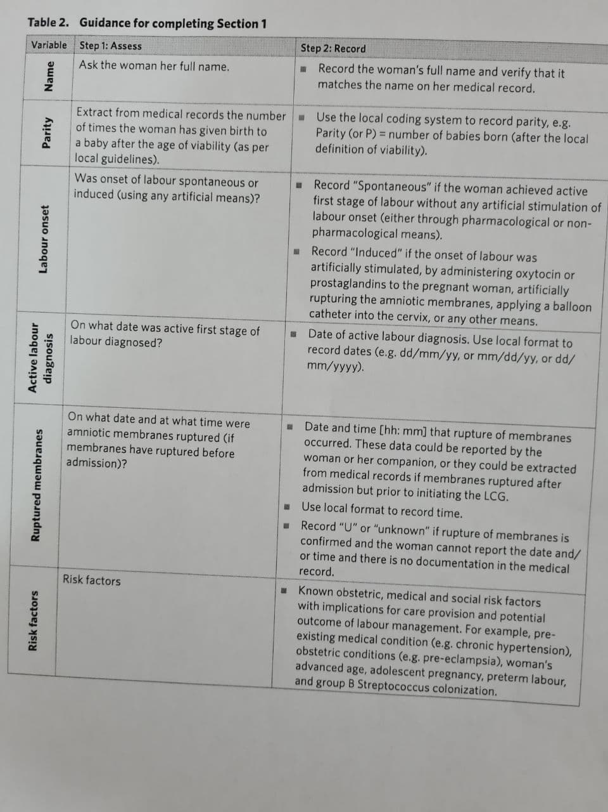

Slide 11


Slide 12
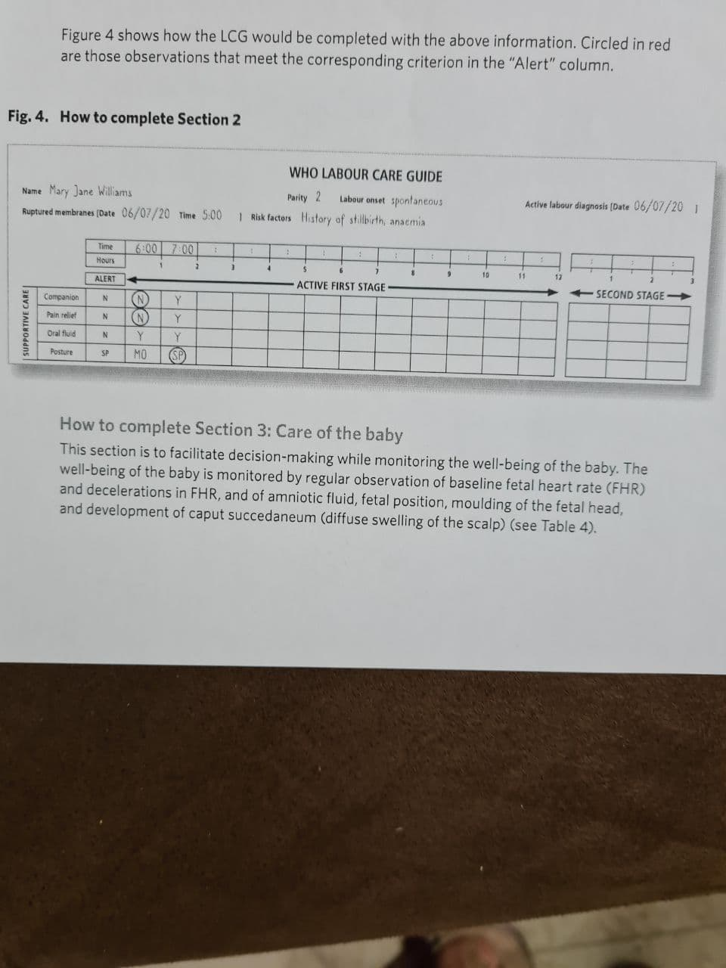

Slide 13


Slide 14


Slide 15


Slide 16
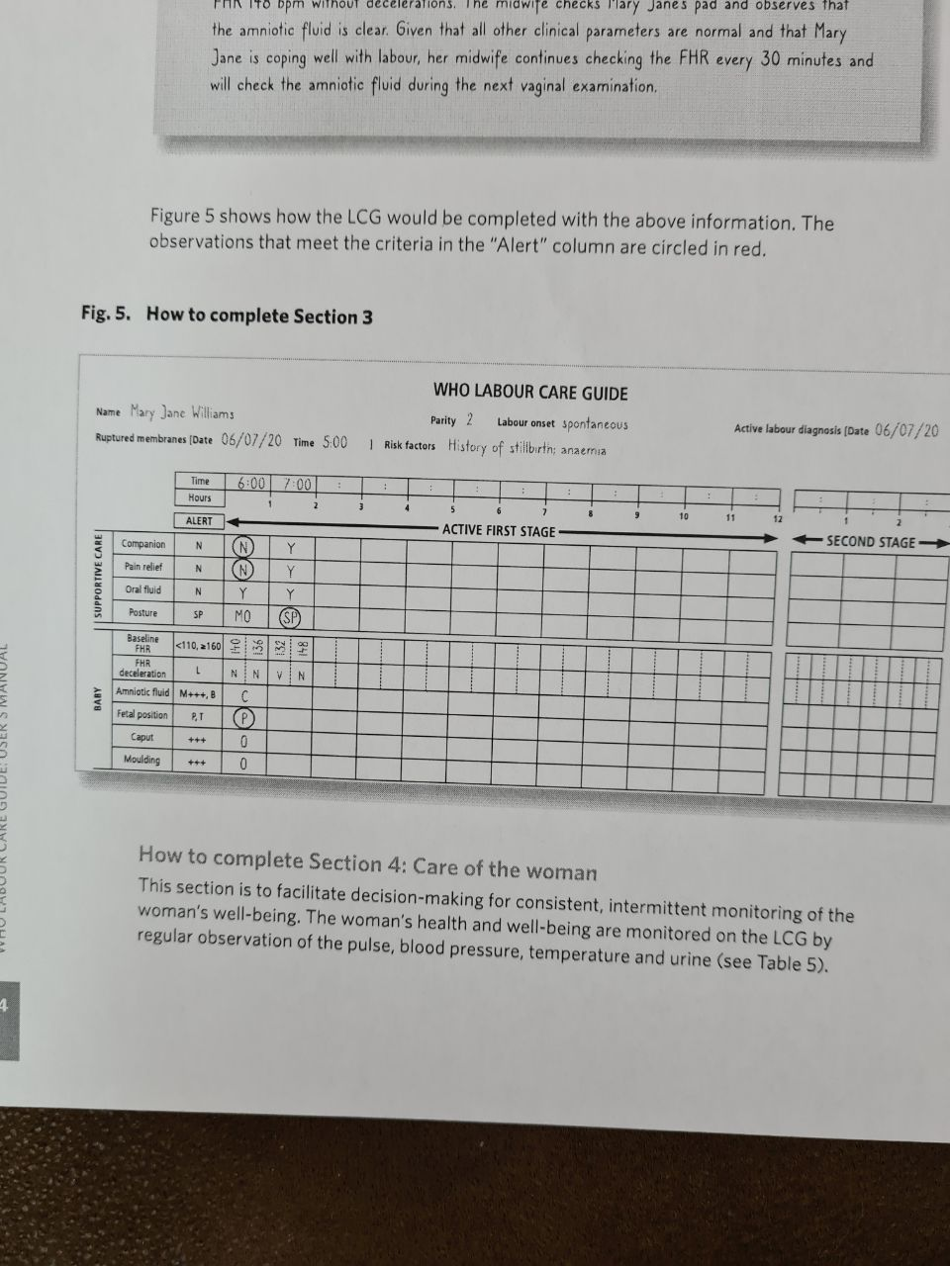

Slide 17


Slide 18


Slide 19


Slide 20
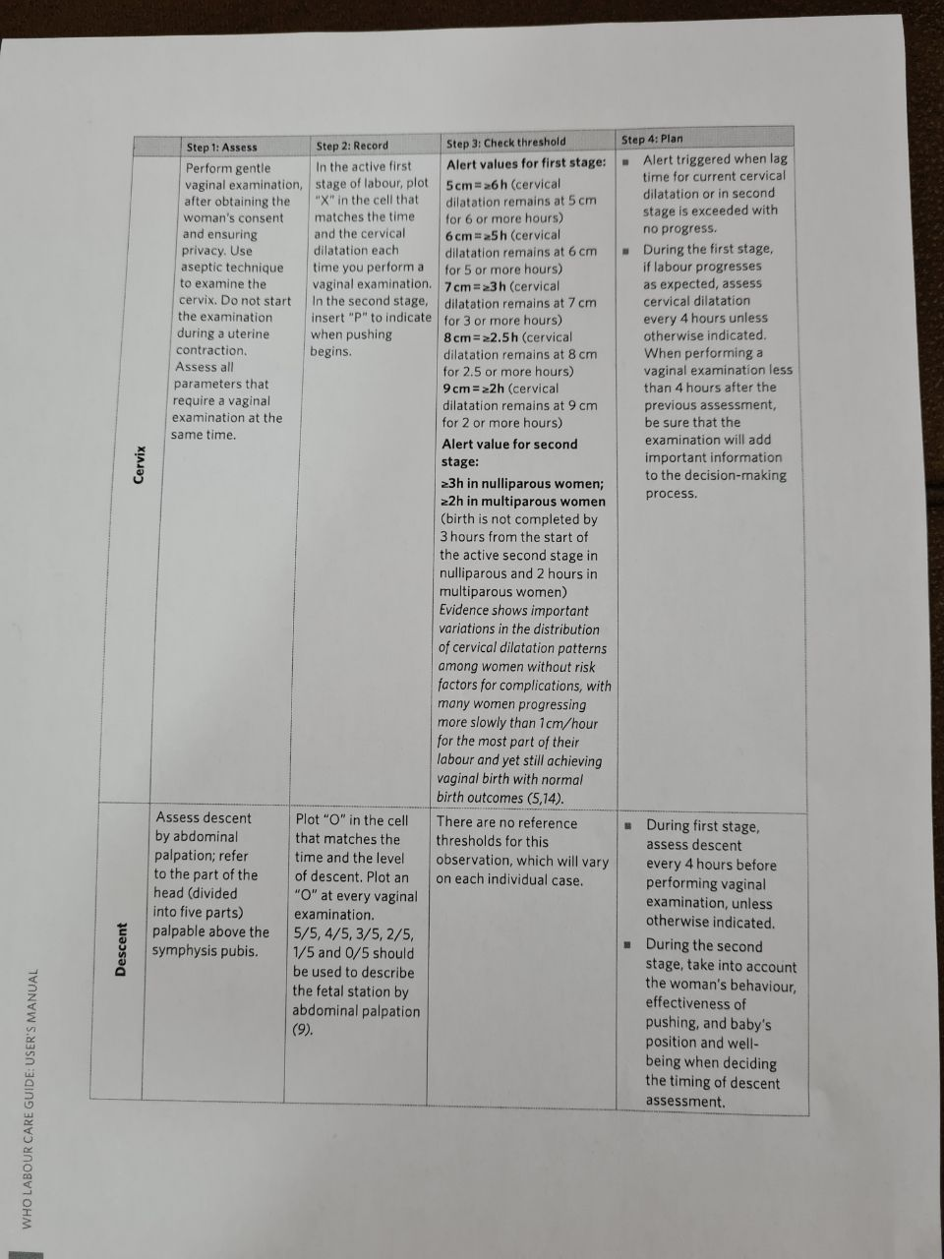

Slide 21


Slide 22
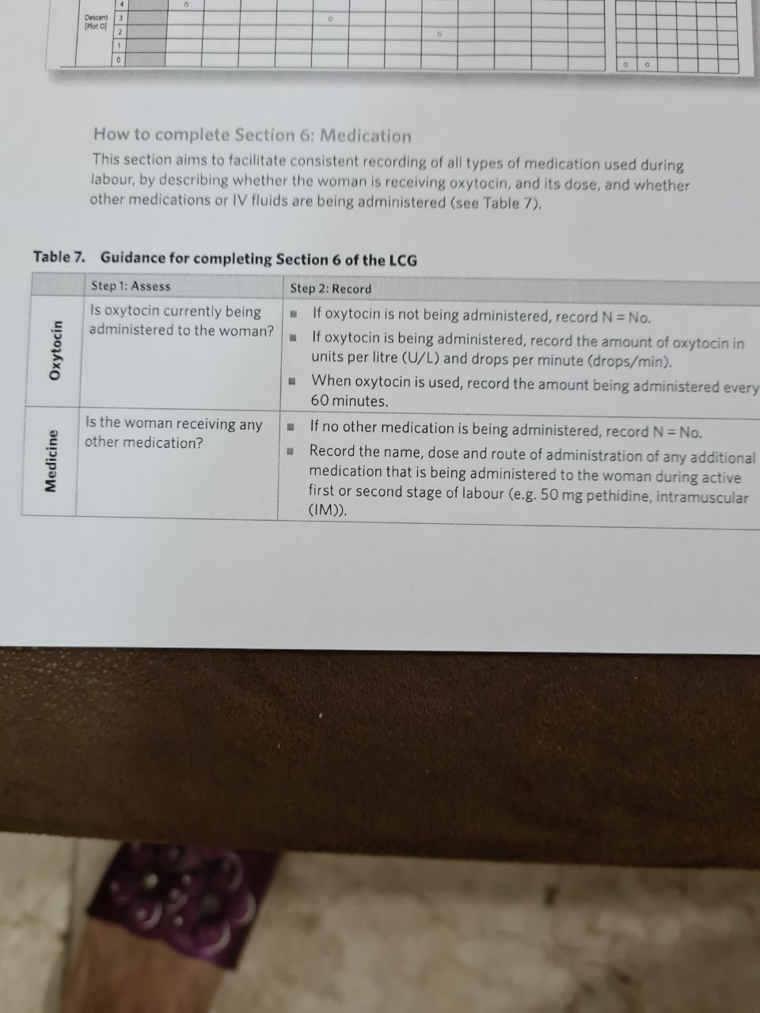

Slide 23


Slide 24
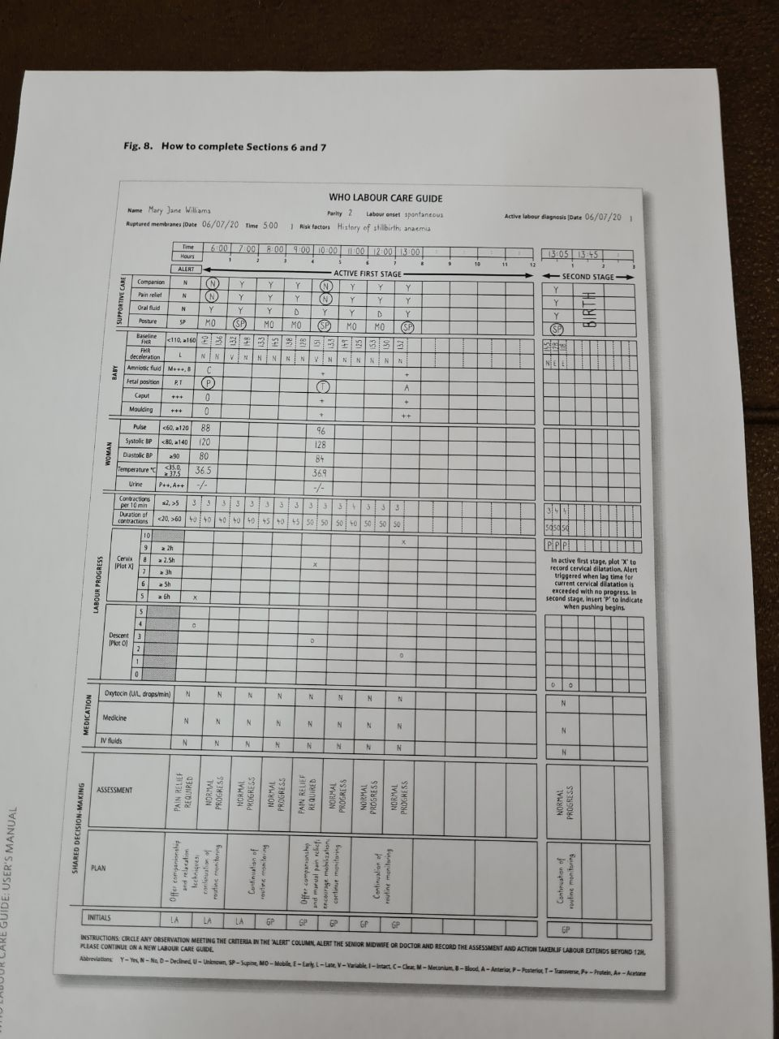

Slide 25
Summary list of recommendations on intrapartum care for for a positive childbirth experience
Care throughout labour and birth
 | The use of the following definitions of the latent and active first stages of labour is recommended for practice: "" The latent, first stage is a period of time characterized by painful uterine contractions and variable changes of the cervix, including some degree of effacement and slower progression of dilatation up to 5 cm for first and subsequent labours. "" The active first stage is a period of time characterized by regular painful uterine contractions, a substantial degree of cervical effacement and more rapid cervical dilatation from 5 cm until full dilatation for first and subsequent labours. | First stage of labour Definitions of the latent and active first stages of labour

Slide 26
 | Women should be informed that a standard duration of the latent first stage has not yet been established and can vary widely from one woman to another. However, the duration of active first stage (from 5 cm until full cervical dilatation) usually does not extend beyond 12 hours in first labours, and usually does not extend beyond 10 hours in subsequent labours. | Duration of the first stage of labour 6.

Slide 27
Progress of the first
stage of labour
7. For pregnant women with spontaneous labour onset, the cervical dilatation rate threshold of 1 cm/hour during active first stage (as depicted by the partograph alert line) is inaccurate to identify women at risk of adverse birth outcomes and is therefore not recommended for this purpose.( not)
8. A minimum cervical dilatation rate of 1 cm/hour throughout active first stage is unrealistically fast for some women and is therefore not recommended for identification of normal labour progression. A slower than 1 cm/hour cervical dilatation rate alone should not be a routine indication for obstetric intervention.( not )
9. Labour may not naturally accelerate until a cervical dilatation threshold of 5 cm is reached. Therefore, the use of medical interventions to accelerate labour and birth(such as oxytocin augmentation or caesarean section)before this threshold is not recommended, provided that fetal and maternal conditions are reassuring.( not )

Slide 28
Labour ward admission policy
10. For healthy pregnant women presenting in spontaneous labour, a policy of delaying labour ward admission until active first stage is recommended
Clinical pelvimetry on admission
11. Routine clinical pelvimetry on admission in labour is not recommended for healthy pregnant women. Not recommended Routine assessment of fetal well-being on labour admission( not )
12. Routine cardiotocography is not recommended for the assessment of fetal well-being on labour admission in healthy pregnant women presenting in spontaneous labour.( not)
13. Auscultation using a Doppler ultrasound device or Pinard fetal stethoscope is recommended for the assessment of fetal well-being on labour admission.

Slide 29
14. Routine perineal/pubic shaving prior to giving vaginal birth is not recommended. Not recommended
15. Administration of an enema for reducing the use of labour augmentation is not recommended.
16. Digital vaginal examination at intervals of four hours is recommended for routine assessment of active first stage of labour in low-risk women.
18. Intermittent auscultation of the fetal heart rate with either a Doppler ultrasound device or Pinard fetal stethoscope is recommended for healthy pregnant women in labour. Recommended
Epidural analgesia for

Slide 30
pain relief
. Epidural analgesia is recommended for healthy pregnant women requesting pain relief during labour. This dependson a woman’s preferences. Recommended
Opioid analgesia for pain relief
. Parenteral opioids, such as fentanyl, diamorphine and pethidine, are recommended options for healthy pregnant women requesting pain relief during labour. This depends on a woman’s preferences.

Slide 31
Category of recommendation | Recommendation | Care option First stage of labour
recommended | Relaxation techniques such as including progressive muscle relaxation, breathing, music, mindfulness and other techniques are recommended for healthy pregnant women requesting pain relief during labour. This depends on a woman’s preferences. | Relaxation techniques for pain management
Recommended | Manual techniques, such as massage or application of warm packs, are recommended for healthy pregnant women requesting pain relief | Manual techniques for pain management
Recommended | For women at low risk, oral fluid and food intake during labour are recommended. | Oral fluid and food
Recommended | Routine vaginal cleansing with chlorhexidine during labour for the purpose of preventing infectious morbidities is not recommended. | Vaginal cleansing
Not recommended | A package of care for active management of labour for prevention of delay in labour is not recommended. | Active management of labour
Not recommended | The use of early amniotomy with early oxytocin augmentation for prevention of delay in labour is not recommended. | Early amniotomy and oxytocin
Not recommended | The use of antispasmodic agents for prevention of delay in labour is not recommended. | Antispasmodic agents

Slide 32
Category of recommedation | Recommendation | Care option Second stage of labour
Recommended | Women in the expulsive phase of the second stage of labour should be encouraged and supported to follow their own urge to push. | Method of pushing
Context-specific recommendation | For women with epidural analgesia, delaying pushing for one to two hours after full dilatation or until the woman regains the sensory urge to bear down is recommended in the context where resources are available for longer stay in second stage and perinatal hypoxia can be adequately assessed and managed. | Method of pushing (for women with epidural analgesia)
 | For women in the second stage of labour, techniques to reduce perineal trauma and facilitate spontaneous birth (including perineal massage, warm compresses and a “hands on” guarding of the perineum) are recommended, based on a woman’s preferences and options available to her. | Techniques for preventing perineal trauma

Slide 33
 |  | Care of the woman after birth
Recommened | . Postpartum abdominal uterine tonus assessment for early identification of uterine atony is recommended for all women. | Uterine tonus assessment
Not recommened | . Routine antibiotic prophylaxis is not recommended for women with uncomplicated vaginal birth Routine antibiotic prophylaxis is not recommended for women with episiotomy All postpartum women should have regular assessment of vaginal bleeding, uterine contraction, fundal height, temperature and heart rate (pulse) routinely during the first 24 hours starting from the first hour after birth. Blood pressure should be measured shortly after birth. If normal, the second blood pressure measurement should be taken within 6 hours. Urine void should be documented within 6 hours. Recommended Discharge following uncomplicated vaginal birth. | Antibiotics for uncomplicated vaginal Birth Routine postpartum maternal assessment

Slide 34
Third stage of labour
Prophylactic uterotonics
. The use of uterotonics for the prevention of postpartum haemorrhage (PPH) during the third stage of labour isrecommended for all births.
. Oxytocin (10 IU, IM/IV) is the recommended uterotonic
drug for the prevention of postpartum haemorrhage
(PPH) In settings where oxytocin is unavailable, the use of other
injectable uterotonics (if appropriate, ergometrine/
methylergometrine, or the fixed drug combination of
oxytocin and ergometrine) or oral misoprostol (600 μg) is
recommended.

Slide 35
Delayed umbilical cord clamping (not earlier than 1 minute after birth) is recommended for improved maternal and infant health and nutrition outcomes.
Controlled cord traction (CCT)
. In settings where skilled birth attendants are available,
CCT is recommended for vaginal births if the care provider and the parturient woman regard a small reduction in blood loss and a small reduction in the duration of the third stage of labour as important. Recommended
Uterine massage . Sustained uterine massage is not recommended as an
intervention to prevent postpartum haemorrhage in women who have received prophylactic oxytocin.

Slide 36
 |  | Care of the newborn
recommended | All newborns, including low birth-weight babies who are able to breastfeed, should be put to the breast as soon as possible after birth when they are both clinically stable, and the mother and baby are ready. | Breastfeeding
recommended | . All newborns should be given 1 mg of vitamin K intramuscularly after birth (i.e. after the first hour by which the infant should already be in skin-to-skin contact with the mother and breastfeeding should already be initiated). | Haemorrhagic disease prophylaxis using vitamin K
recommened | Bathing should be delayed until 24 hours after birth. If this is not possible due to cultural reasons, bathing should be delayed for at least six hours. Appropriate clothing of the baby for ambient temperature is recommended. This means one to two layers of clothes more than adults, and use of hats/caps. The mother and baby should not be separated and should stay in the same room 24 hours a day. | Bathing and other immediate postnatal care of the newborn

Slide 37
Warm and clean room
Sufficient examination tables or beds with clean
linens
Light source
Heat source
Clean and accessible bathrooms for the use of
women in labour
Curtains if more than one bed
Medication
Bag of IV fluids
Oxytocin
Injectable magnesium sulfate
Antibiotics
Antiretroviral
Antihypertensive
Analgesics
Anaesthetic

Slide 38
Hand washing
Clean water supply
Soap
Nail brush or stick
Clean towels
Alcohol-based hand rub
Equipment
Sphygmomanometer or other blood pressure
machine
Stethoscope
Body thermometer
Fetal stethoscope or Doppler

Slide 39
Waste
Bucket for soiled pads and swabs
Receptacle for soiled linens
Container for sharps disposal
Sterilization
Instrument sterilizer
Jar for forceps
Vacuum extractorSupplies
Gloves
Urinary catheter
Syringes and needles
Sterilized blade/scissors
IV tubing
Suture material for tear or episiotomy repair
Antiseptic solution (iodophors or chlorhexidine)
Spirit (70% alcohol)
Swabs
Bleach (chlorine-based compound)
Impregnated bed net
Urine dipsticks
Clamps
Oxygen cylinder/concentrator

Slide 40
THANK YOU

Slide 41


Slide 42
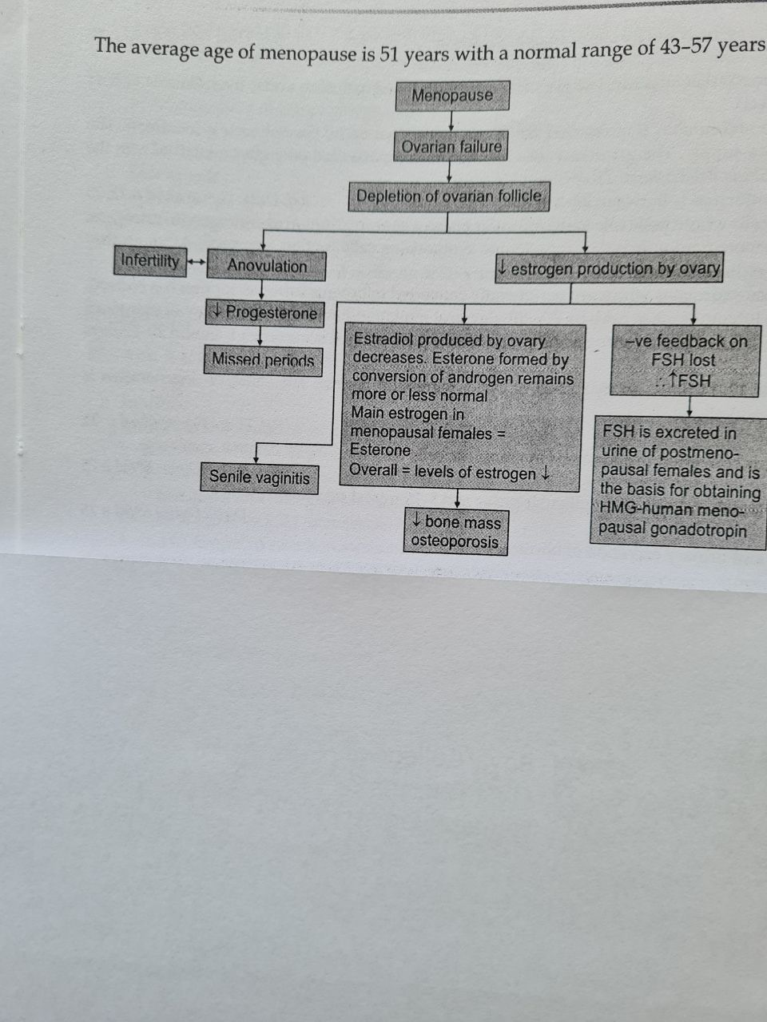

Slide 43
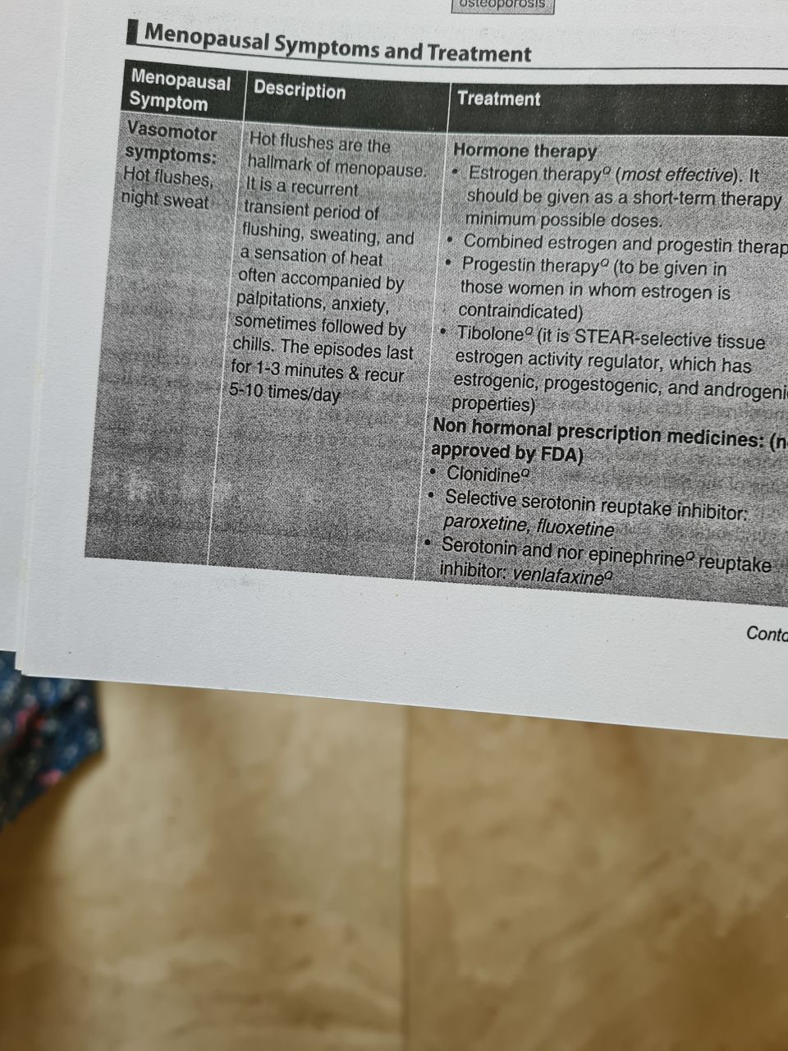

Slide 45
